Slide 1
Setup and Timing
Setup:
Minecraft: Education Edition launched and logged in on all machines
Demo Accounts: mee01-mee100@minecrafteducationediton.com / Build2019
If multi-player is enabled, during free play at the end of the session kids play together, but not during the Coding Challenges
At the end of the session, have them close out of their world (but don’t shut down the game!)
Timing (45):
Intro (3)
Getting Started with Minecraft (7)
Getting Started with MakeCode (5)
Coding Challenge #1 – Events flower trail (5)
Coding Challenge #2 – Coordinates glass box (5)
Coding Challenge #3 – Agent house (10)
Free Code + Show and Tell (5)
Close (5)

Slide 2

Microsoft MakeCode for Minecraft
Student Zone – Build It
Notes:
Introduce speaker/helper – Name, What you do at Microsoft, What you studied in School
These are beginner level labs.
There is a big diversity of experience here, and we don’t want to leave anyone behind.
If you are more advanced – please help others, code in JavaScript (we’ll be running these labs in Blocks), and feel free to add more complexity and experiment with your programs and mods
There is also a DIY area available if you want to continue working on your programs after this lab

Slide 3
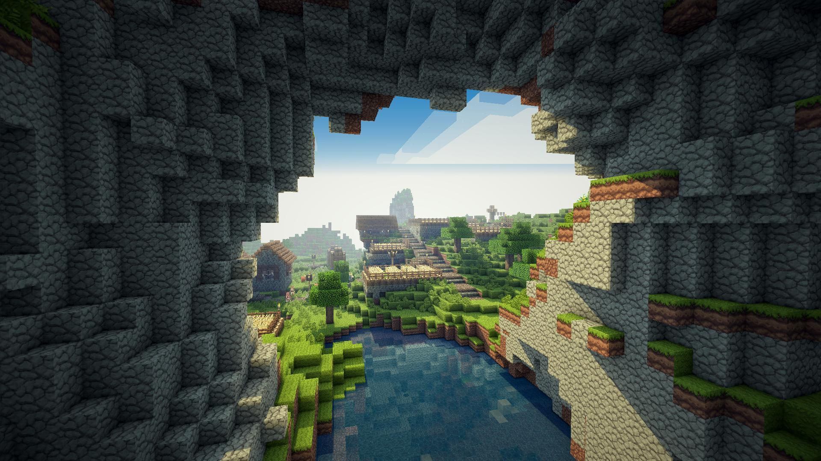
What is Minecraft?
No Rules
No end-game
Play the way you want
Notes:
First let’s start off talking about Minecraft
Who’s played Minecraft before?
Can you explain what is Minecraft? And how do you play?
That’s right, it’s a bit of a weird game in that there is no real rules, and no real end game objective.
And there are different modes you can play in depending on how you want to play – Creative, Survival, Adventure
It’s a ton of fun! And even more fun when you can code in it!

Slide 4
Minecraft: Education Edition
Simple, Secure Login
Students and educators use Office 365 Education accounts to log in to Minecraft: Education Edition. This ensures secure access to the game and student data privacy.
Education Edition Skins
Skins allow students to personalize their avatars, increasing student engagement and allowing educators to more easily differentiate students playing together.
Flexible Multiplayer
An entire classroom can play in a world together without any need for an external server.
Allow and Deny Blocks
Educators can set editable or immutable areas of the world – allowing, or denying, students the ability to build and focusing the learning to specific spaces.
Border Blocks
Border Blocks help teachers define specific areas in the game that their students can build in.
Fixed Inventory
Fixed Inventory slots provide educators with an opportunity to define specific inventory available to students, such as a camera, portfolio, or other blocks or tools.
Non-Player Characters
A Non-Player Character, or NPC, can be placed in the game to provide information to students, give direction, and link to other resources.
Chalkboards
Educators can use chalkboards to communicate learning goals or challenge students with problems to solve within the game.
Camera and Portfolio
The Camera allows students to capture images of their work. The portfolio is where students save images of the work they’ve captured with the Camera, including an option to add captions.
Classroom Mode
Classroom Mode is an extension of Minecraft: Education Edition that provides educators with more control of a Minecraft world and the students within it.
Code Builder
Code Builder is an extension of Minecraft: Education Edition that allows educators and students to connect their Minecraft world to popular learn-to-code platforms.
Notes:
There is an Education version of Minecraft that has a few more features which are good for learning
We’ll be using the Code Builder feature today

Slide 5
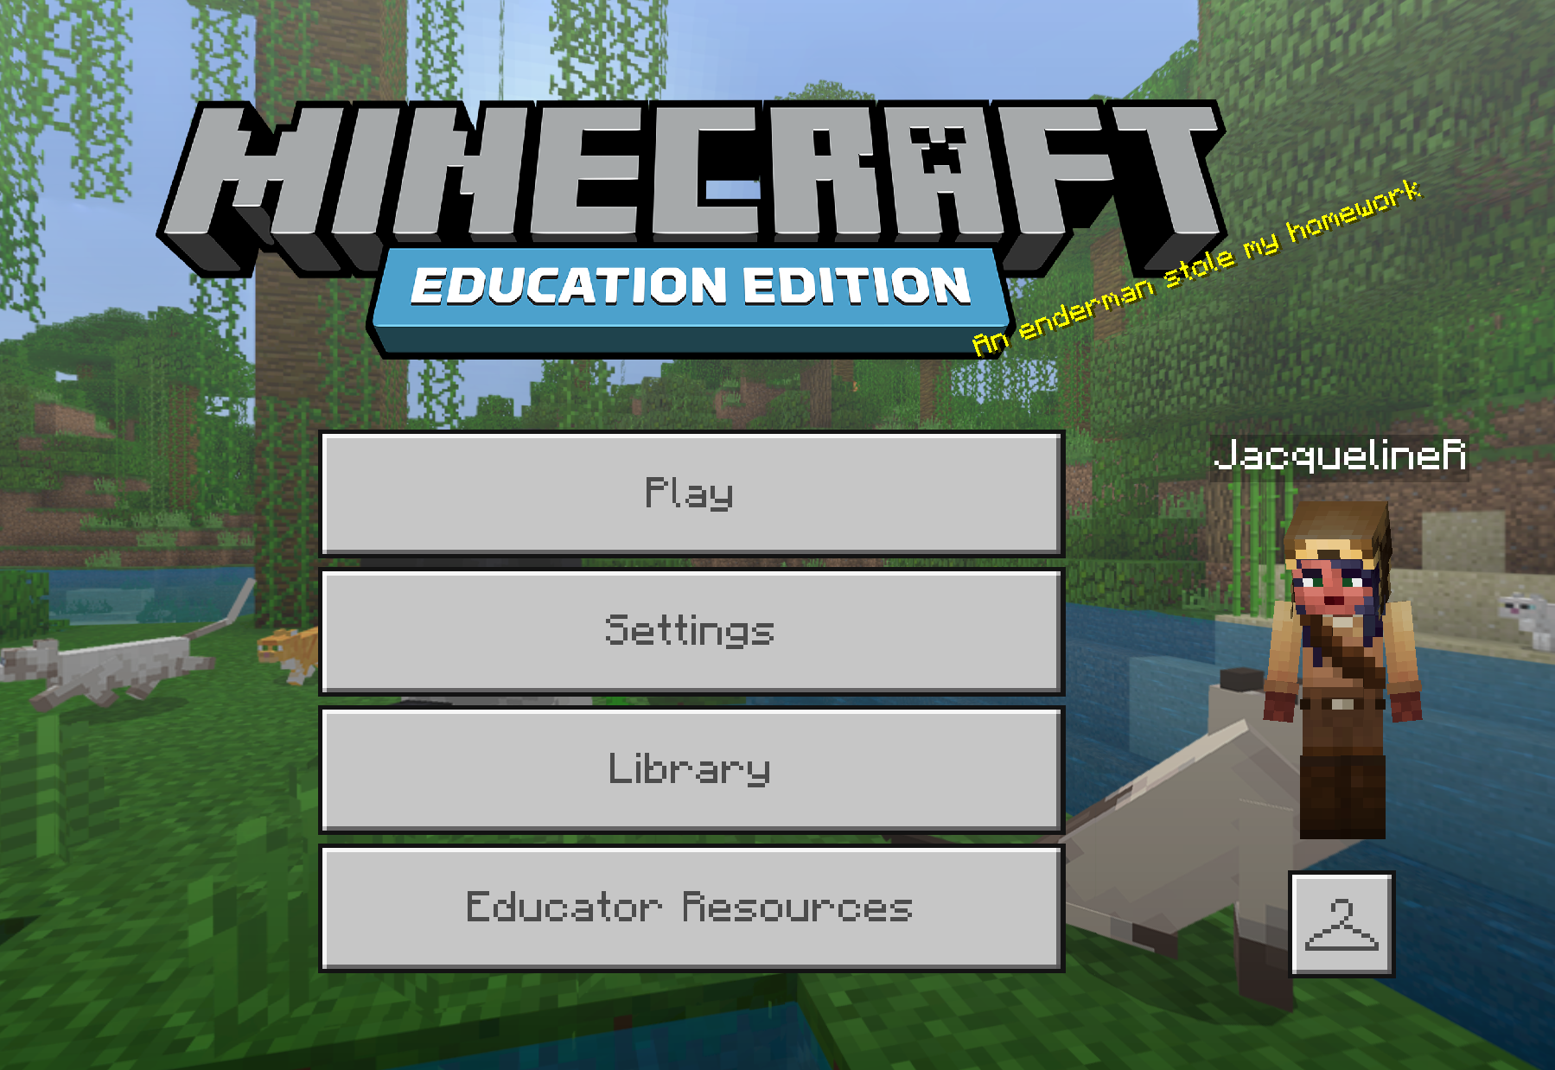
Notes:
Change skin if you want
Click Play

Slide 6
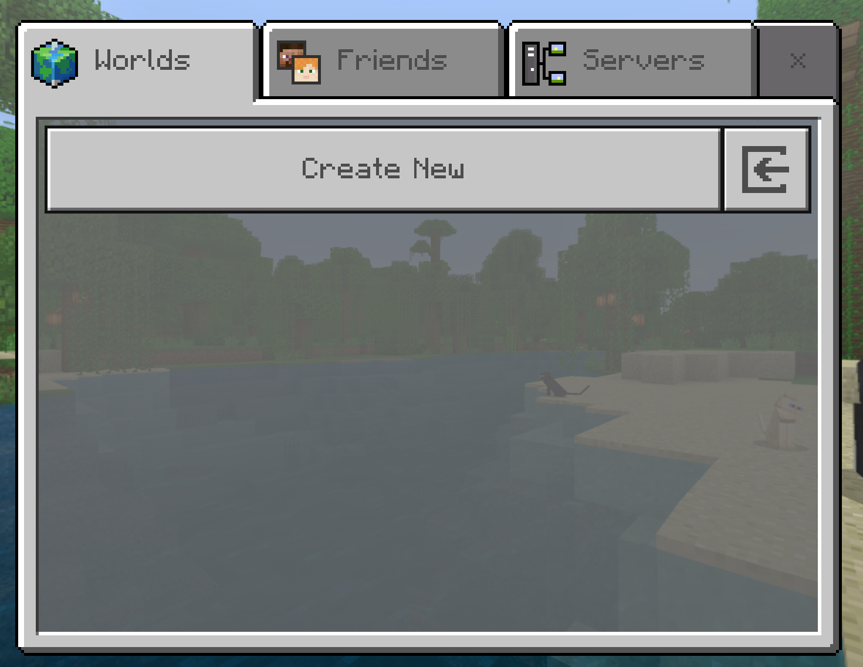
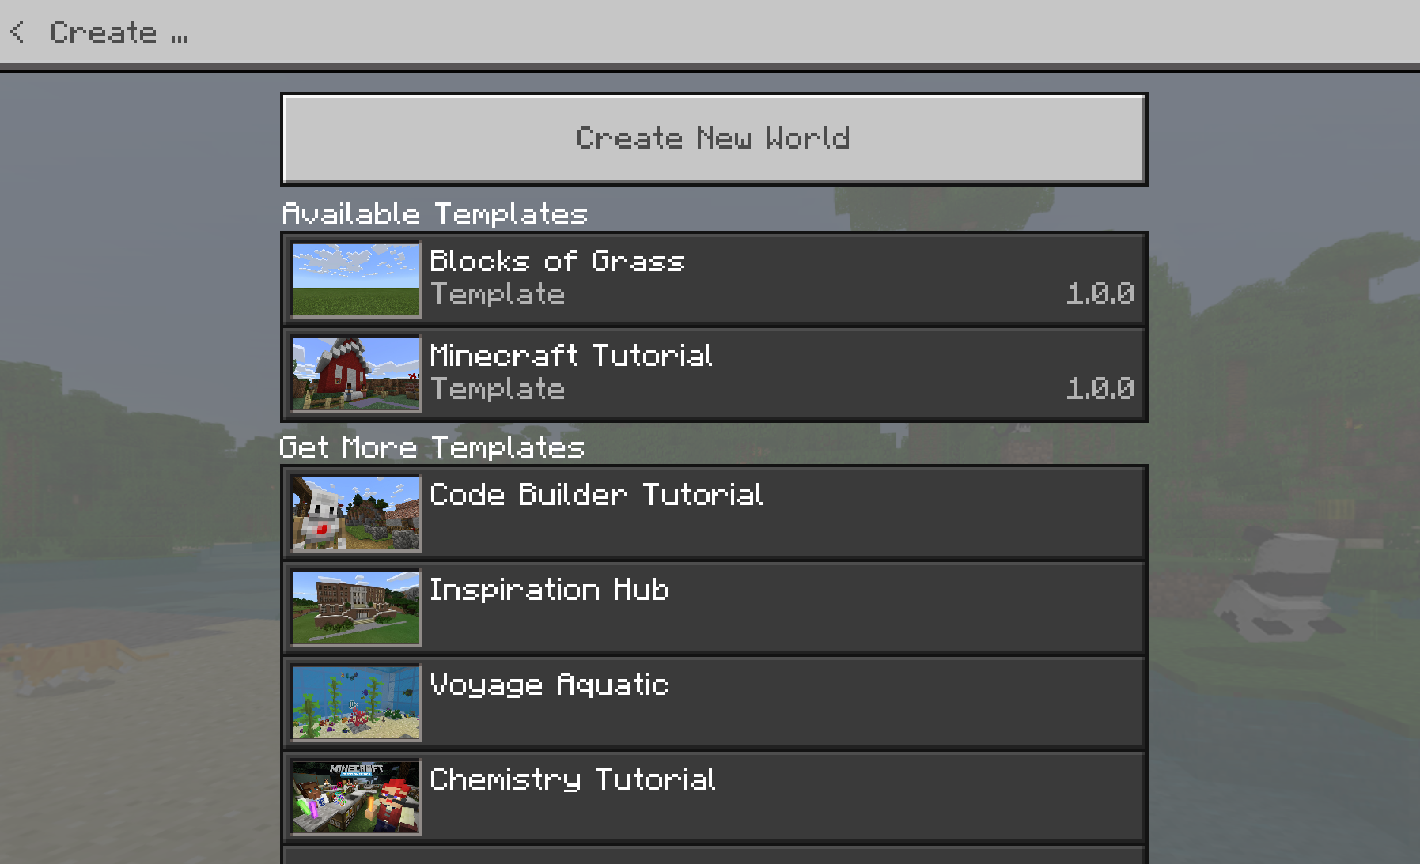
Notes:
Create New
Create New World (don’t use an existing Template)

Slide 7
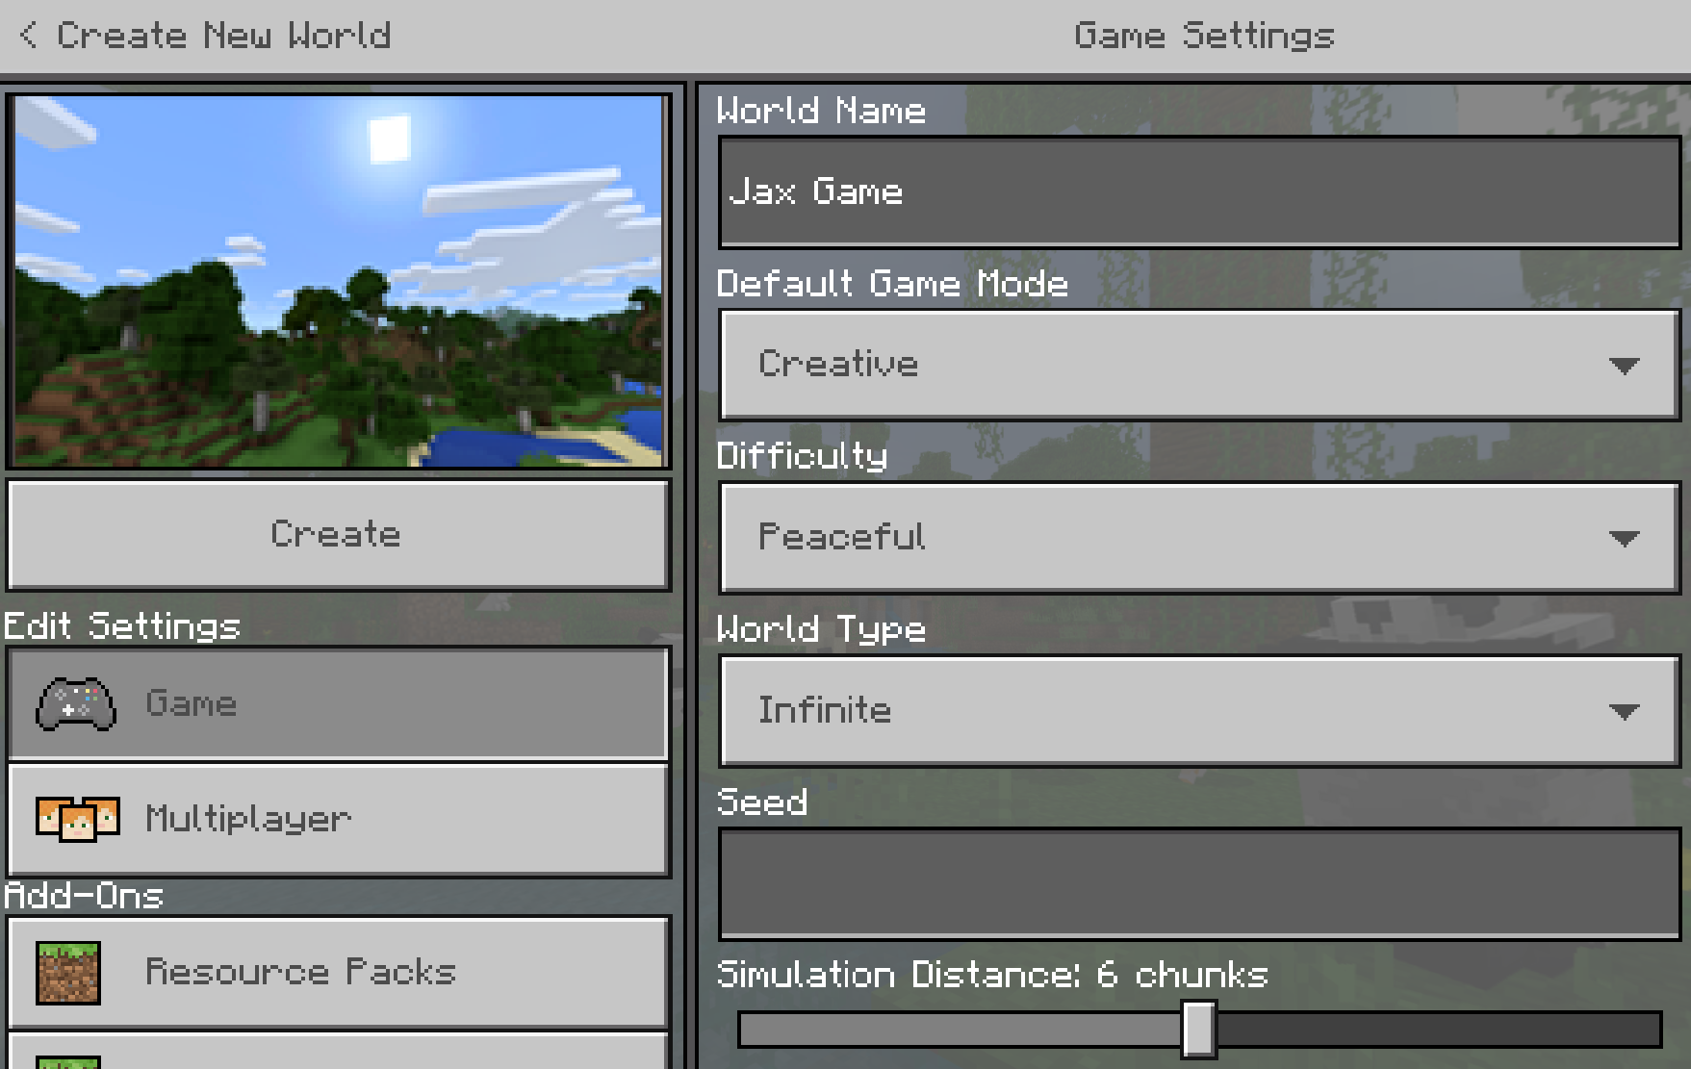
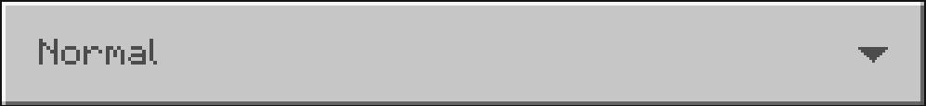
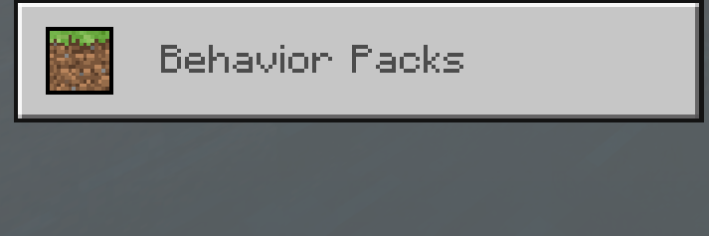
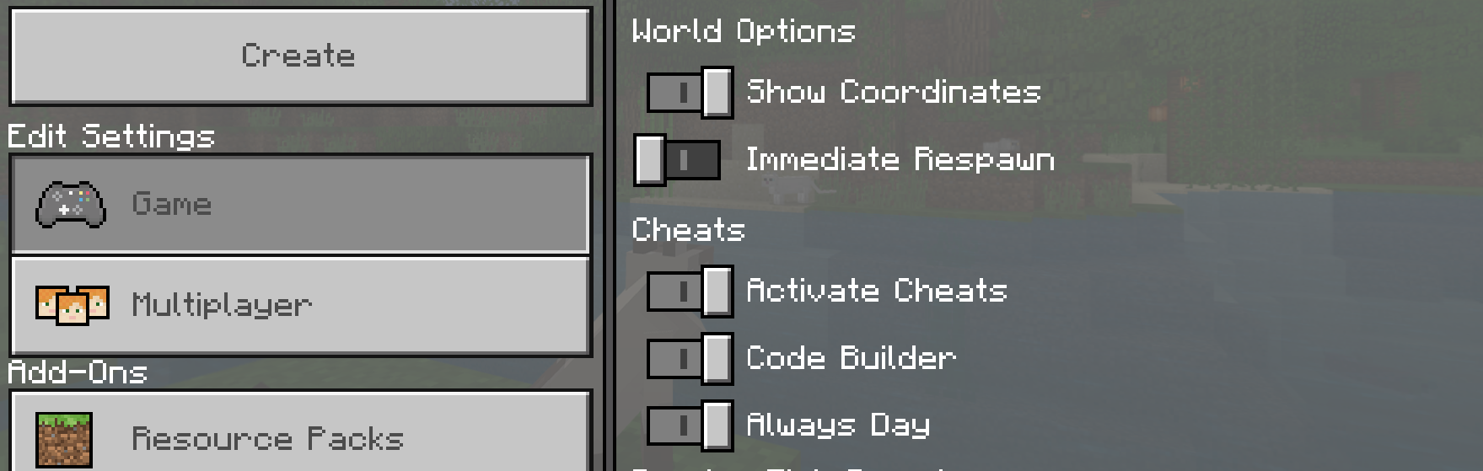
Notes:
Give your world a Name
Set to Creative mode for this lab
Set to Normal (so we can spawn monsters if we want)
Show Coordinates
Activate Cheats, Code Builder, and Always Day
Click Create

Slide 8
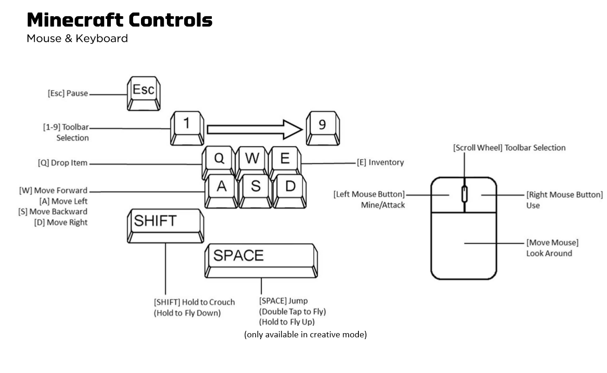
T
Opens the chat window
Notes:
For those who have never played before, here’s a cheat-sheet of the controls in the game
The main ones to remember are WASD to move
T to open the chat window
And the space bar to jump or fly

Slide 9
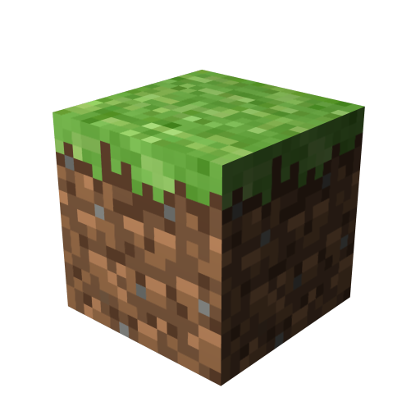
New to Playing Minecraft Challenges
Move forward, backwards, left and right ( WASD )
Look around ( mouse )
Jump up onto a block ( W + Space bar )
Fly ( double-tap Space bar )
Break a block ( mouse left-click )
Put block into Toolbar
Open Inventory ( E )
Click and release to move blocks over
Notes:
Note – if everyone has played Minecraft before, you can skip this section
Let’s spend a little time getting used to Minecraft
Here’s a few challenges to help you get familiar with the Minecraft environment
For those who have played before – please help your neighbors who may be new to Minecraft

Slide 10
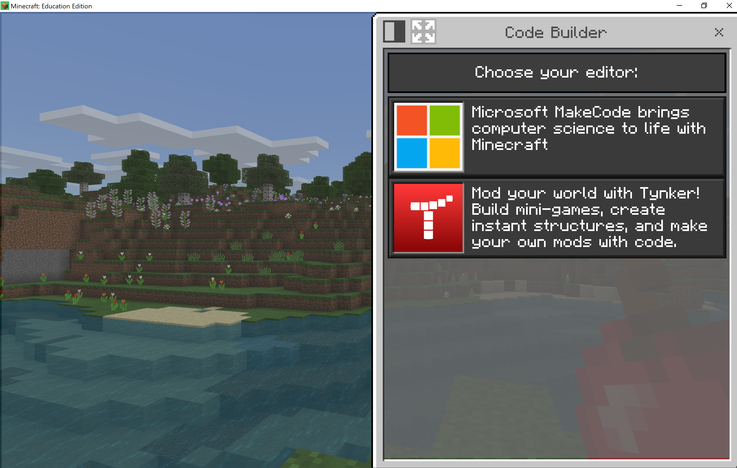
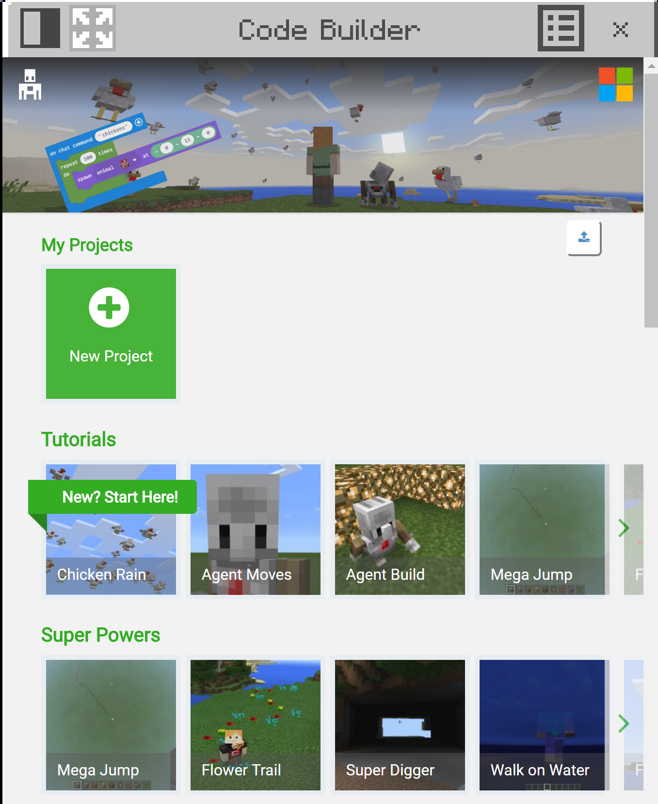
Open MakeCode
Press ‘C’ on the keyboard to open Code Builder window
Click on Microsoft MakeCode
Expand to full screen if it’s only half screen
Notes:
Alright, let’s get started Coding!
Press C to open up the Code Builder window
Select MakeCode if you need to (Note – should only have to do this the first time on each computer)
You should see the MakeCode Home page
Expand to Full Screen (if it’s not already)

Slide 11
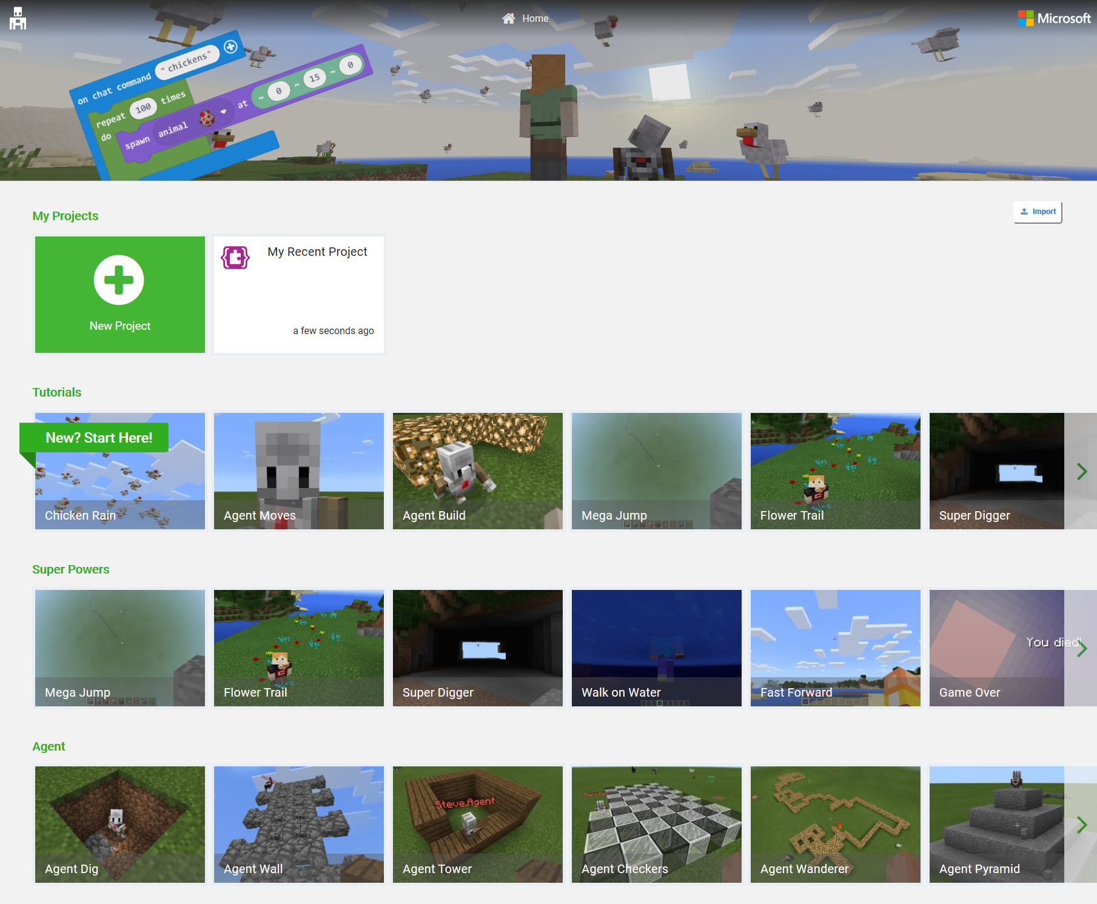
MakeCode Home Page
Notes:
On the MakeCode Home Screen, you can find:
Your recent projects
Step-by-step tutorials
And code samples categorized into different areas
Let’s go ahead and click on the green button to create a New Project

Slide 12
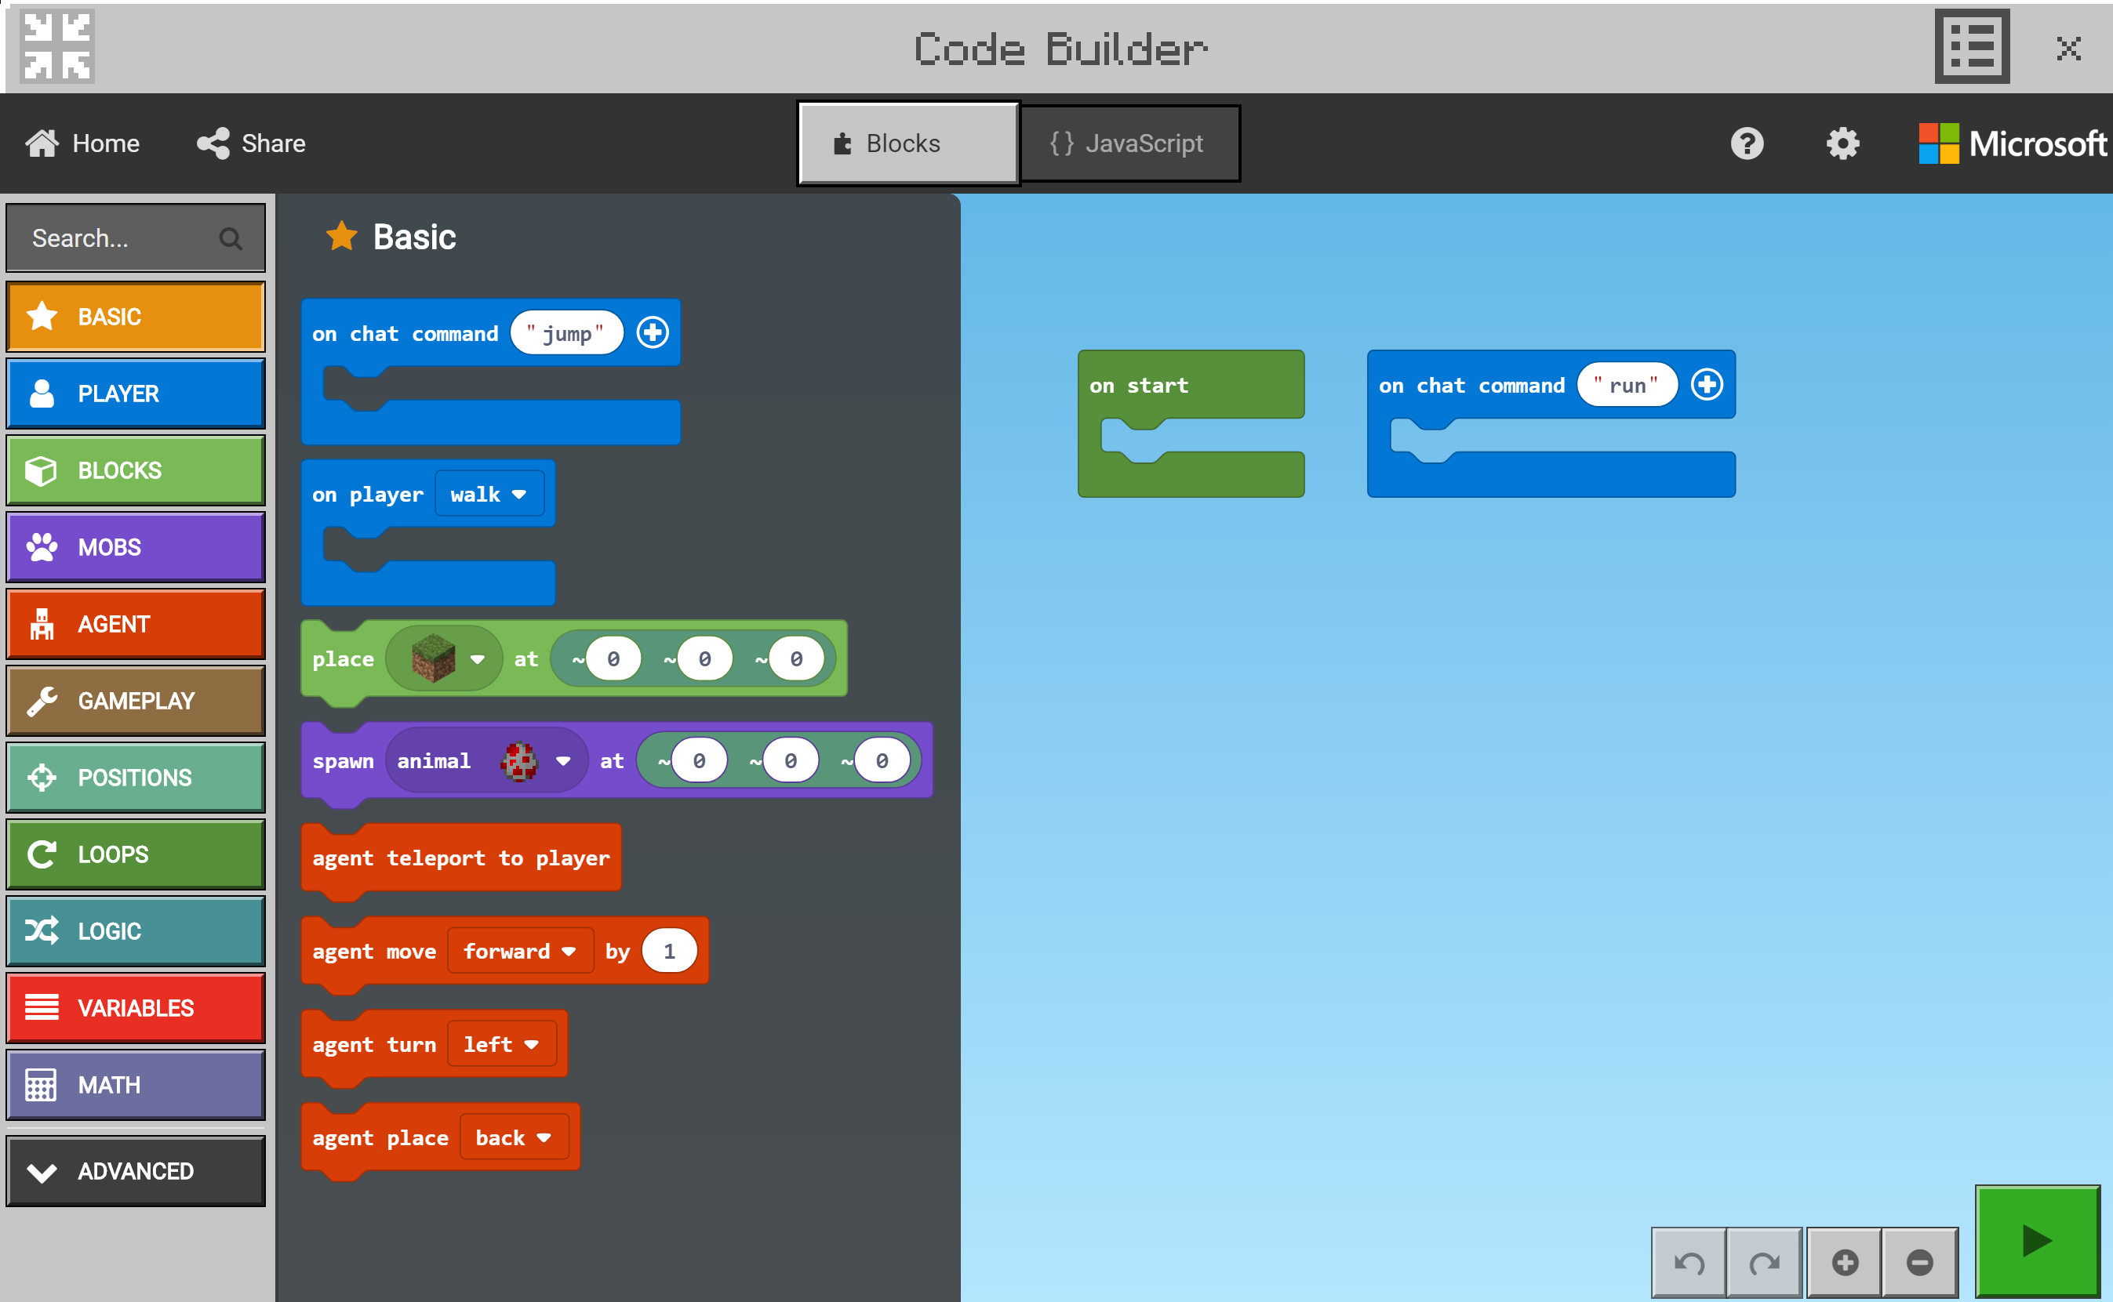
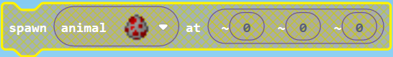
Editor
Toolbox
Basic category contains most common blocks
Workspace
Build your program here
Disabled blocks
Don’t run
Run Code
Will close code editor and run code in game
Notes:
This is the MakeCode editor:
On the left side is the block Toolbox with different categories of code blocks that you can use in your program
On the right side is the programming Workspace where we’ll be constructing our programs and mods
Disabled blocks look grey when they’re not connected to a top-level event handler – this means they won’t run in your program
Delete blocks by dragging and dropping back on the Toolbox, or select and press the Delete key on your keyboard, or right-click and select Delete Block
Green Arrow button will put you back into the Minecraft game where your code will be running
To open up the MakeCode editor again, press the C key on the keyboard

Slide 13
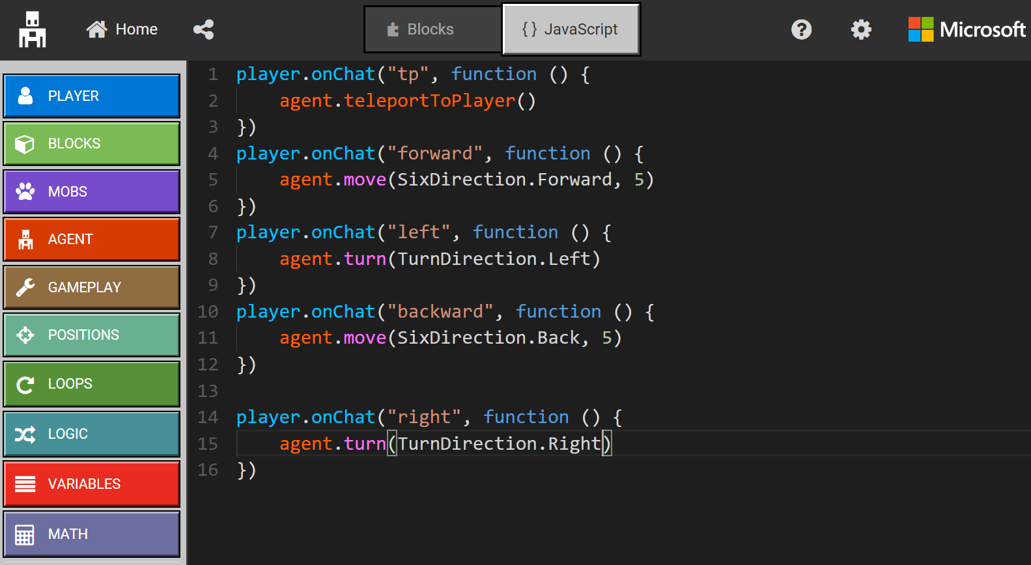
JavaScript
Notes:
Using the Toggle button on the top, you can switch into the JavaScript editor
More advanced students should feel free to program in JavaScript – there is intellisense, code completion and error detection to help you.
You can also use the Toolbox to drag out code snippets into the programming workspace.

Slide 14
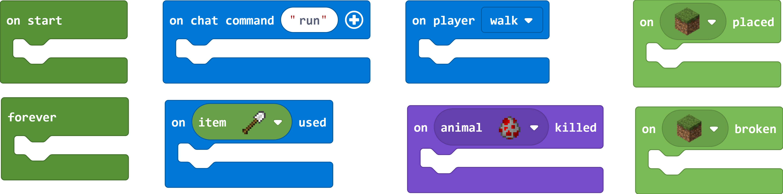
Events
What is an “event”?
a wedding, a funeral, graduation ceremony…
Events can trigger actions:
Event |  | Action
It starts raining | è | Open umbrella
The bell rings | è | Students go to class
The Power button is pressed | è | Computer turns on
Mouse button is clicked | è | Open application
Event handlers determine when to run different blocks of code in your program –
Notes:
Let’s start off talking about Events
As you all know, an event is some sort of occurrence in time – like a wedding, or like this event Build
But what is an event in Computer Science?
It’s also an occurrence, and we use events to trigger certain actions. Events are good for telling the computer WHEN to do something.
Some examples of events that trigger actions are “When it starts Raining” is the event, and “Opening an umbrella” is the action
In MakeCode we have special blocks that look like mouths – with a top and bottom lip. These are called Event Handlers, and the code inside these blocks will run when that event gets triggered.
Who can tell me what event handler I should use if:
I wanted to make it rain when a chicken was killed
I wanted to create a giant hole when I broke a grass block
I wanted to spawn zombie horses continuously
There are a couple special event handler blocks I want to call out here:
The On Chat Command block – allows you to specify a command that you can type in the chat window in the game to run your code
The On Item Used block – will trigger when you have an item in your hand and you right-click

Slide 15
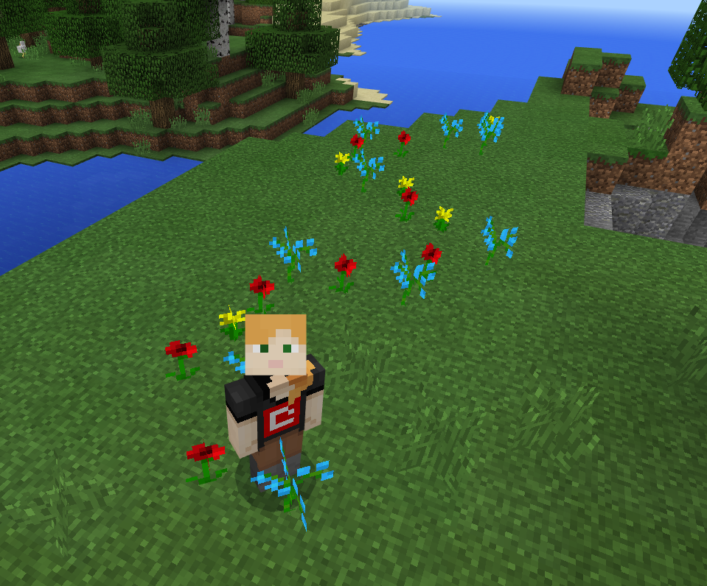
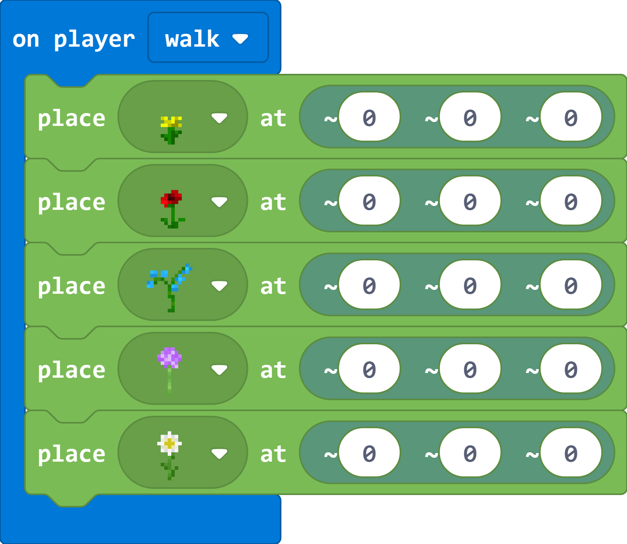
Coding Challenge #1 Flower Trail
Leave a trail of flowers when your player walks around
Advanced Challenges –
When you fly, spawn birds
When you swim, spawn fish
Notes:
Alright, let’s jump into our first coding challenge!
We’re going to use an event to create a trail of flowers behind your player as they walk around in the game
If you get done with this early, try also spawning birds when your player flies and spawning fish when your player swims
Give hints to beginners:
Use the On Player Walk block in the blue Player category
Use the Place block in the green Blocks category
Don’t worry about the coordinates for now – you can leave them at ~0, ~0, ~0
Remind students to help each other! If 1 person has figured it out, they should help others figure it out (but don’t do it for them)
After 5 minutes ask for a volunteer to share their solution with the group

Slide 16
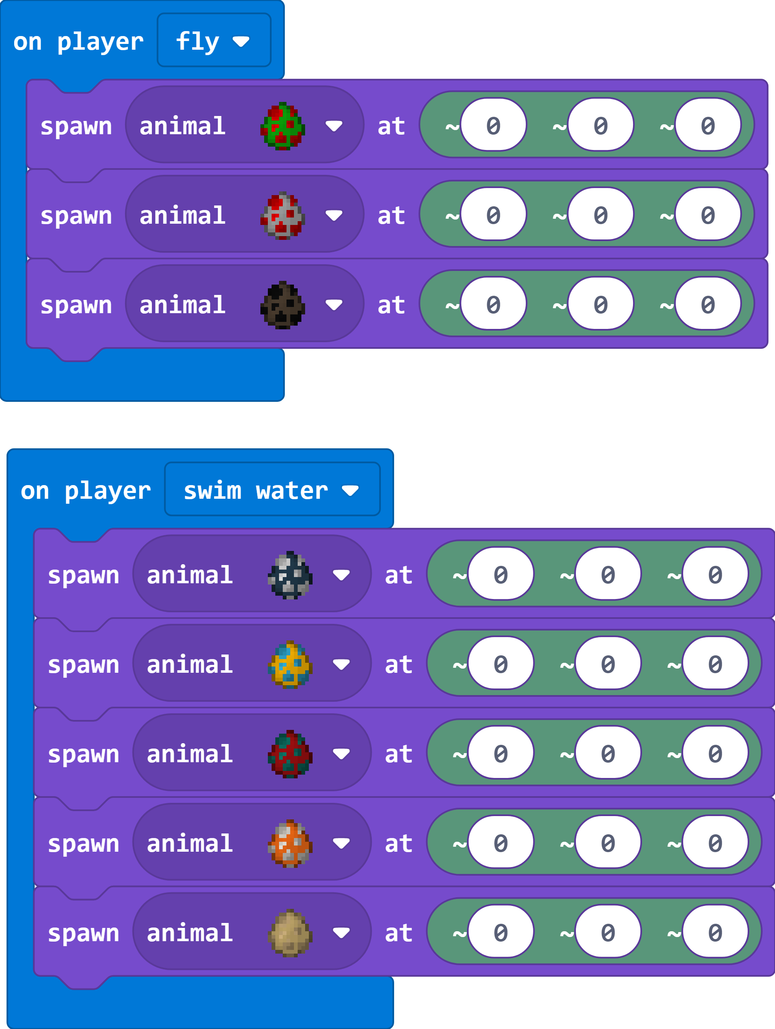
Notes:
https://makecode.com/_H3Cf562q10TC

Slide 17
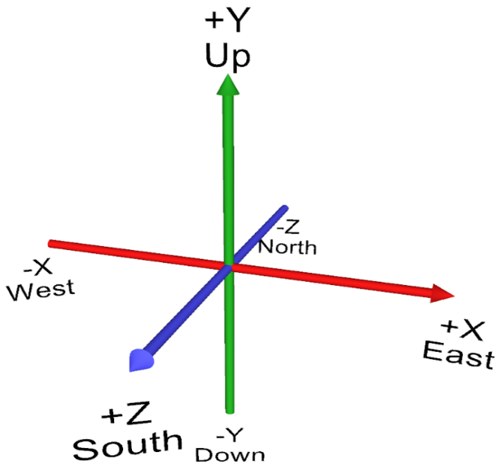
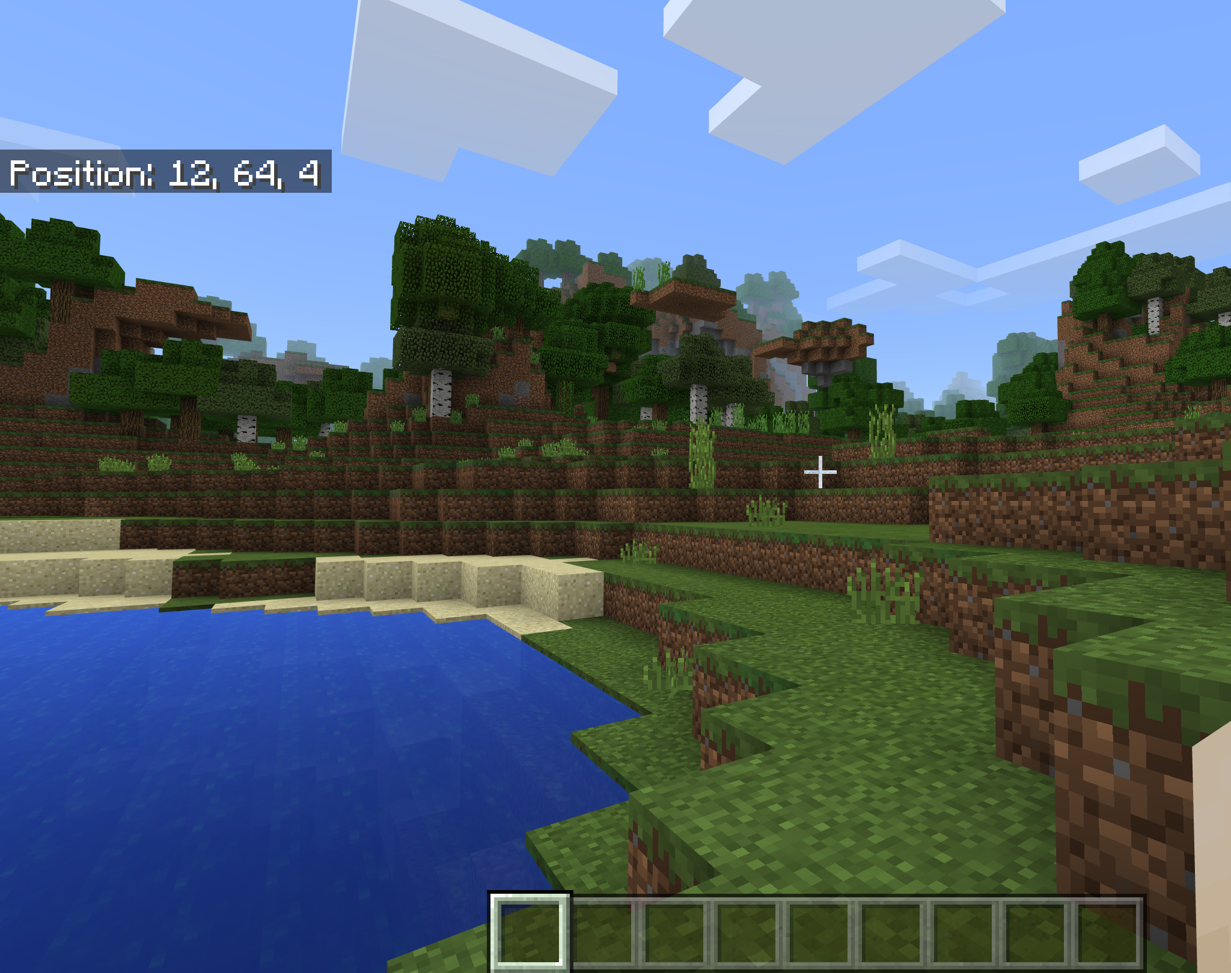
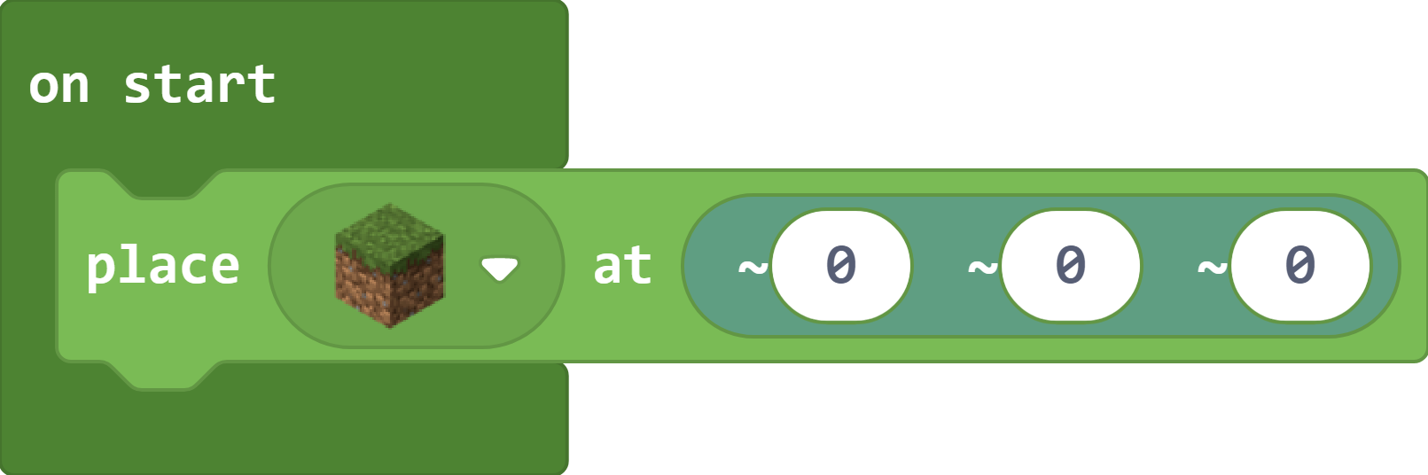
Positions & Coordinates in Minecraft
Player World Position ( X, Y, Z )
X = East, West
Y = Up, Down
Z = South, North
A Position relative to Player location ( ~X, ~Y, ~Z )
Notes:
Now let’s talk about coordinates in Minecraft
This is a bit tricky
A player has a World Position that is represented by 3 coordinates:
X is a position on the East West axis (positive number is East of the World origin, negative number is West of the World Origin)
Y is a position Up or Down
Z is a position on the North South axis (positive number is South of the World origin, negative number is North of the World Origin)
In addition to a World Position, there are also Relative Positions to the Player’s current position that are denoted with a little tilde or squiggle in front of them
We tend to use these relative coordinates more in our coding
What do you think the position of ~0, ~0, ~0 is?

Slide 18
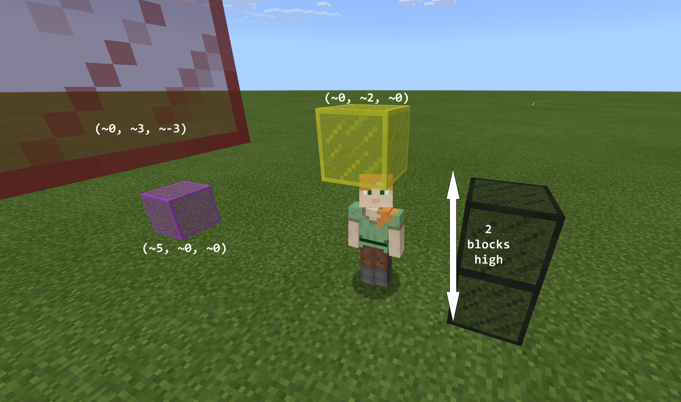
Notes:
A player is 2 blocks high in Minecraft
Here are some examples of relative positions to the player in Minecraft

Slide 19
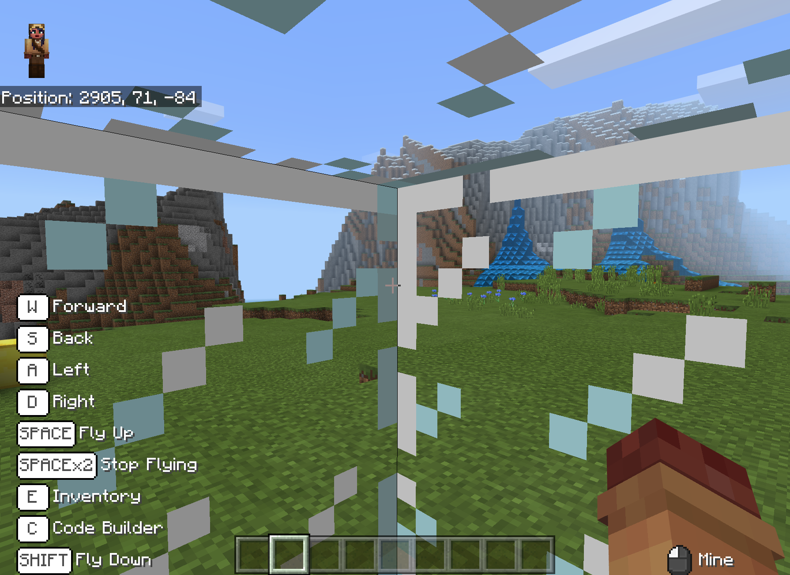
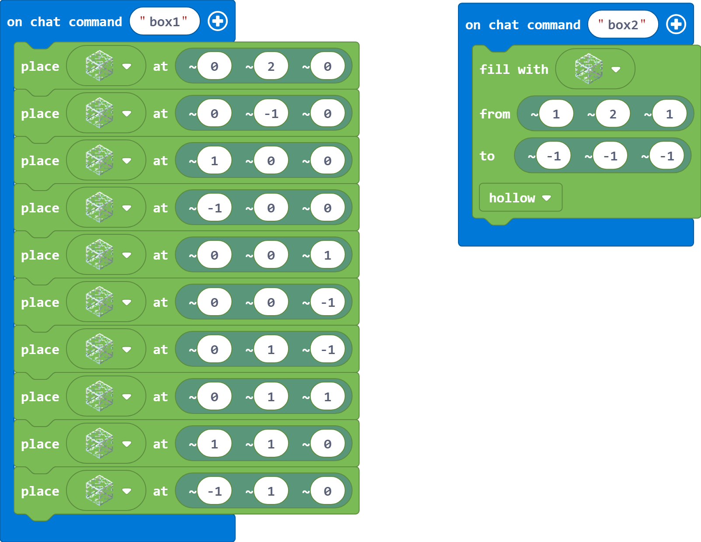
Coding Challenge #2 Glass Box
On chat command “Box” – create a box of glass around your player
Advanced Challenges –
Try using the Print block to print messages in the sky
Try using Shapes to create a sphere around your player
Notes:
Next challenge will test how well you understand Coordinates!
Use the On Chat Command block to place blocks of glass around your player in a box
You may want to move to a flat area in the world for this
If you get done with this early, try also using the Print block to print messages in front of and above your Player’s location
Or, try to find the Shapes blocks and create a hollow sphere around your player
Give hints to beginners:
Use the On Chat Command in the blue Player category
Type “box” in the command text replacing “jump”
Use the Place blocks in the green Blocks category
Find a glass block (you can type in the Search field)
Think about all the coordinates around the player – above, below, on each side of the player…
For more advanced students, explain the Fill block – goes diagonally from top right to bottom left, with an option to replace existing blocks or make hollow
Remind students to help each other! If 1 person has figured it out, they should help others figure it out (but don’t do it for them)
After 5 minutes ask for a volunteer to share their solution with the group

Slide 20
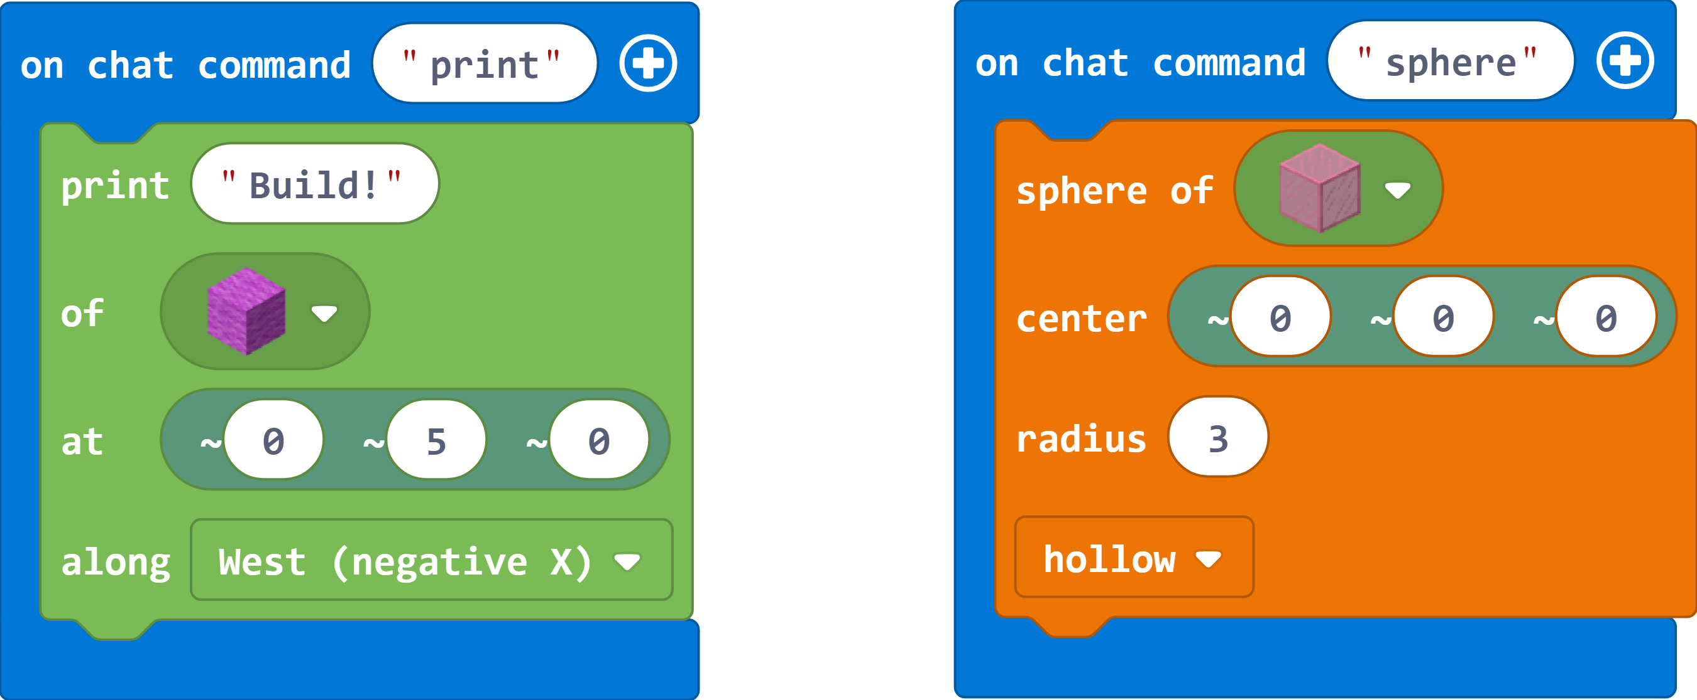
Notes:
https://makecode.com/_YFY74AREADPW

Slide 21
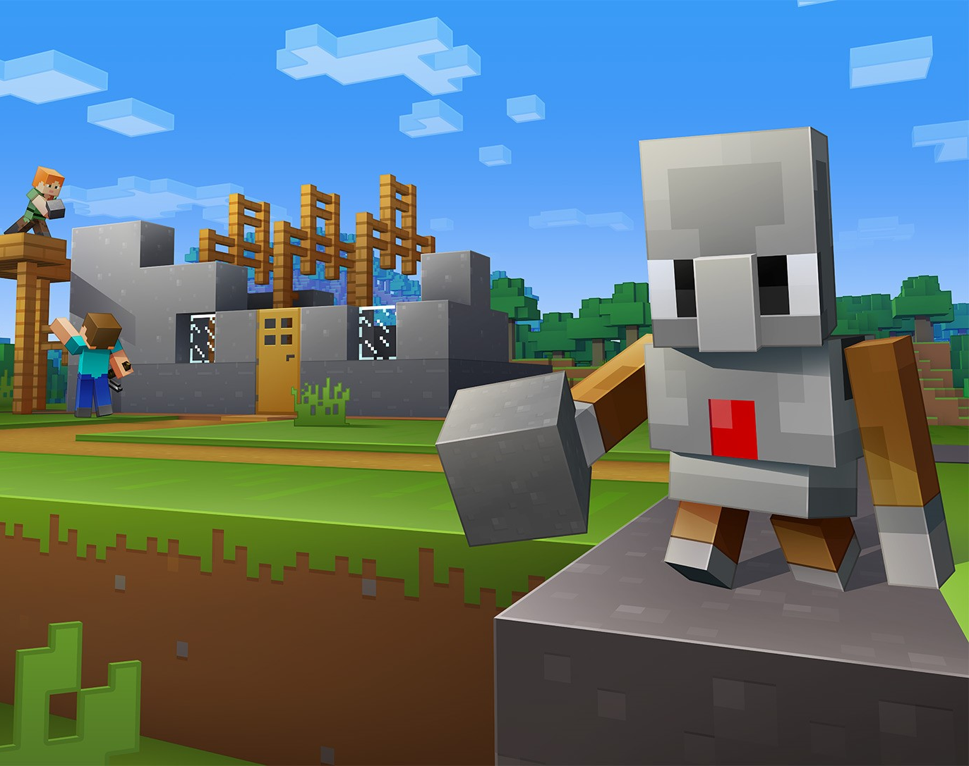
The Agent
Your personal robot to command!
Notes:
In this next part, we get to work with our Agent which is this cute little Robot that can do stuff for us in the game!

Slide 22
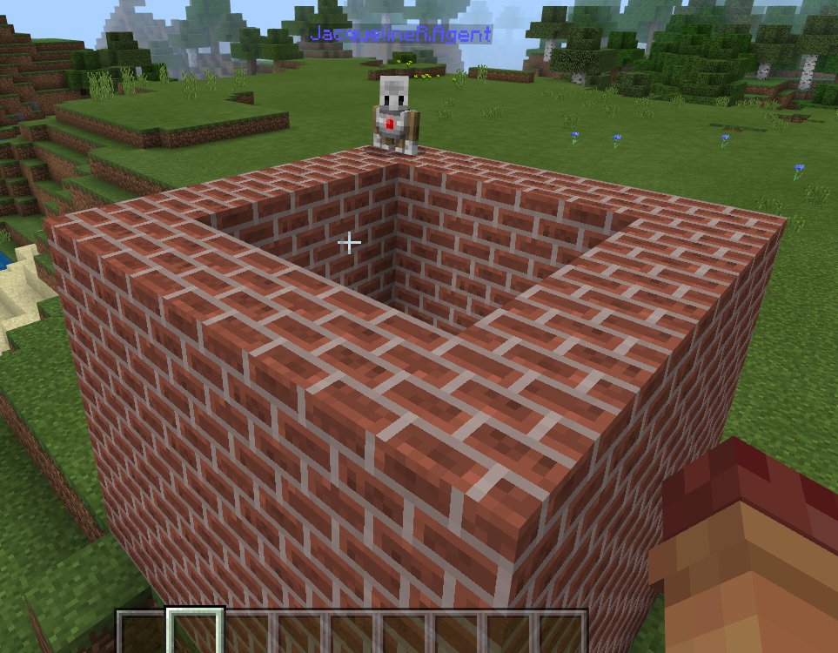
Coding Challenge #3 Build walls of a house with the Agent
Hints:
First teleport your Agent to your Player
Then set blocks in your Agent’s inventory slot 1
Use the Place on Move = True block for your Agent to place a block each time he/she moves
Use the Destroy Obstacles = True block to clear a path for your Agent
Advanced Challenges –
Try adding a roof to your house
Try building a Pyramid
First, try moving your Agent in a square using a Repeat loop
Then think about how you can add layers on top of your square
Notes:
The third and final challenge is to build the walls of a house with your Agent
You may want to move to a flat area in the world for this challenge too
I’m going to give you a little more time to figure this one out
[Let them struggle for a little bit before showing the Hints]
If you get done with this early, try also adding a roof to your house, and super advanced students can think about how you could build a Pyramid using recursion
Remind students to help each other! If 1 person has figured it out, they should help others figure it out (but don’t do it for them)
After 10 minutes ask for a volunteer to share their solution with the group

Slide 23
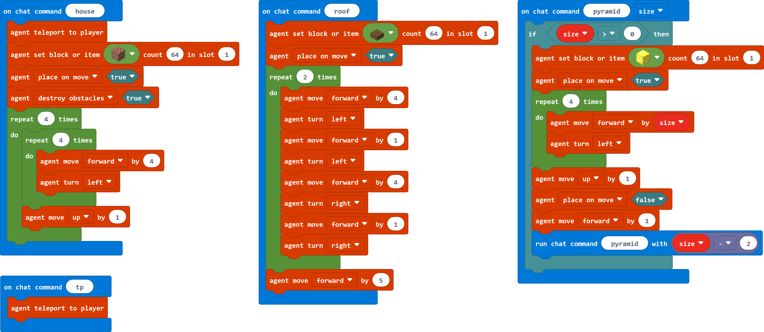
Notes:
https://makecode.com/_R54au6c1588a

Slide 24
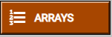
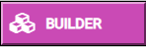
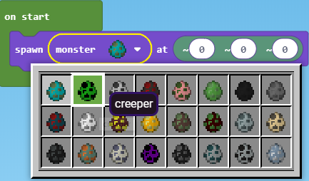
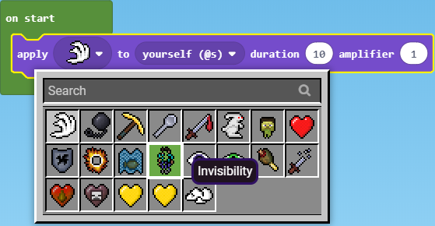
Additional Coding Challenge Ideas
Use Arrays to spawn different types of animals in a Zoo
Use the Builder blocks to instantly create giant structures!
Create a monster defense system
Give yourself super powers using different effects
Notes:
Note – if there is time at the end of the session, give kids some Free Coding time
Here are some additional Coding Challenges and some really cool blocks you can try using
Arrays are a great way to store and iterate through items – try creating arrays of animals or monsters to populate your own Zoo in Minecraft
The Agent can be a bit slow for building – especially if you want to create giant structures. Try using the Builder blocks to set markers and tracing lines for your builds.
Think about helpful ways to defend players against monster attacks – for example, can you create a monster forcefield around your player?
Give yourself super powers using different effects like Invisibility or Super Speed which you can find in the Mobs category
Note – this is also the point at which students can join and play in each others’ worlds if they want

Slide 25
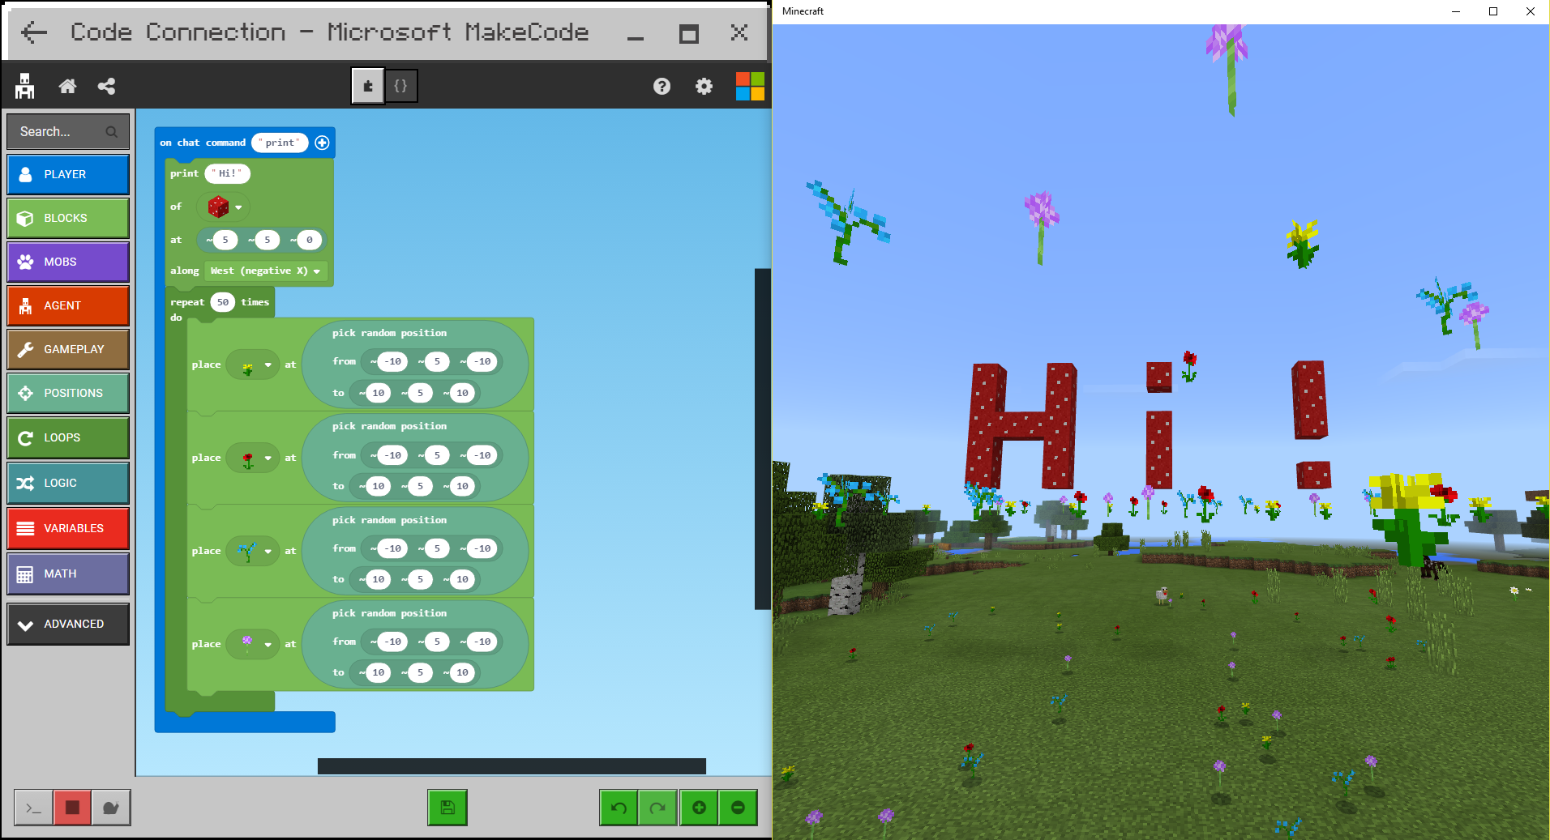
Show & Tell – what did you code?
Notes:
5 minutes until the end of the session, have students share out what they created

Slide 26
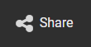
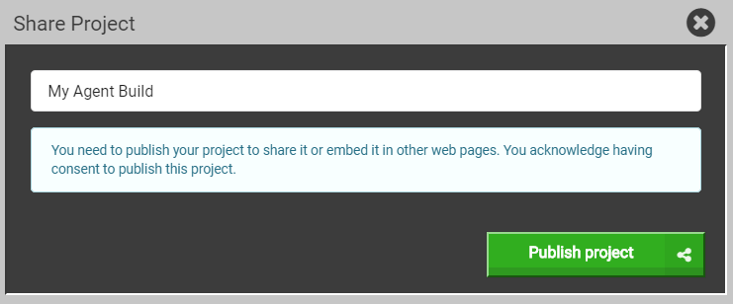
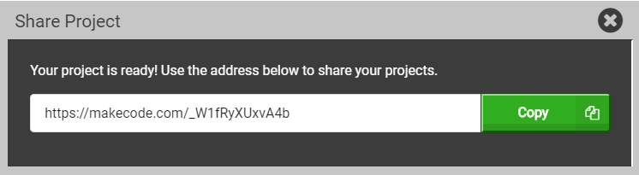
Share your Code
Click the Share button in the top left
Give your project a name
Click the Publish Project button
Copy the URL somewhere (or take a picture)

Slide 27
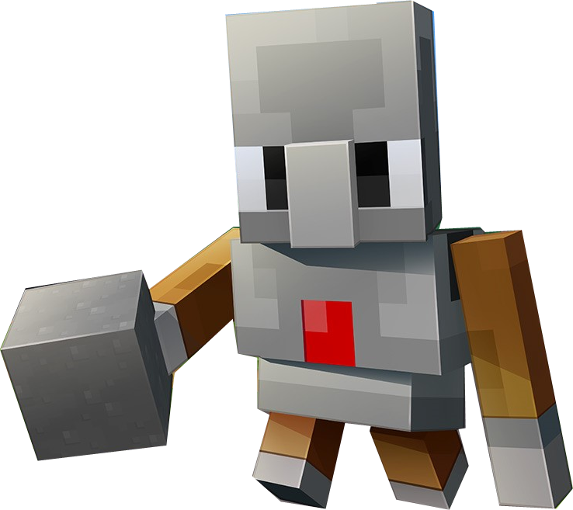
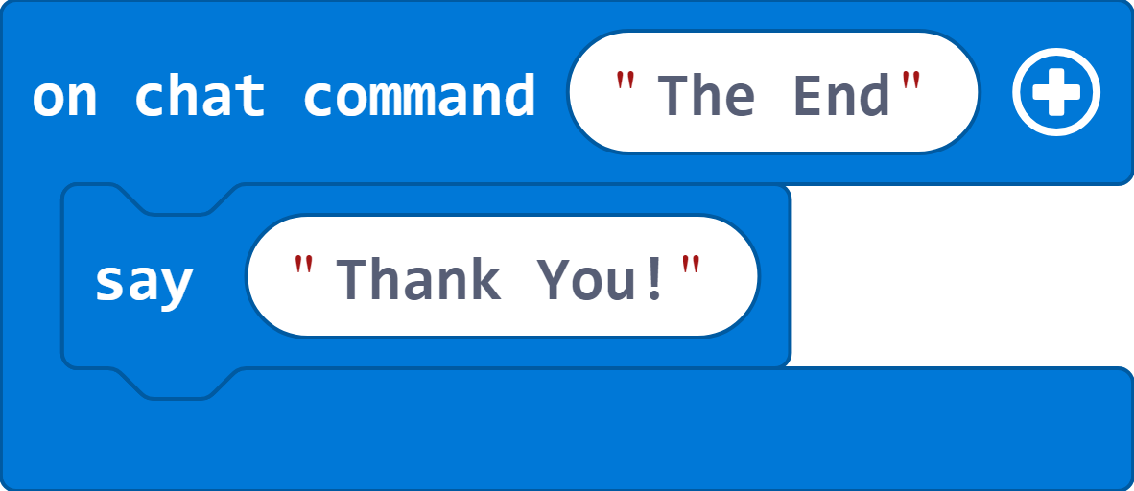
MakeCode for Minecraft
Please fill out Survey! – aka.ms/SurveyMC
More about MakeCode – makecode.com
Coding with Minecraft – minecraft.makecode.com/setup
Notes:
Any last questions before we wrap up?
Here are some links for where you can continue coding using MakeCode for Minecraft at home or at school, and where you can get more information about how to set it up
MakeCode supports both the Minecraft: Education Edition, and Minecraft Windows 10
In the DIY area, Minecraft is also loaded on all the computers there, so feel free to continue working on your programs and mods in that area
Thanks so much for attending!

